Slide 1
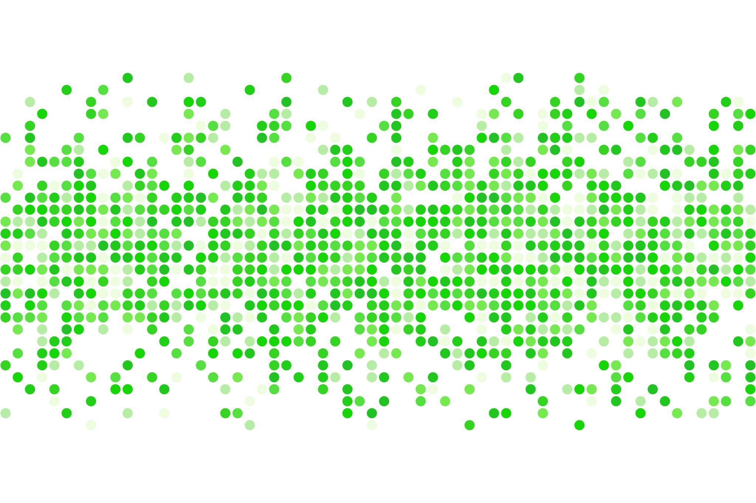
Time for a Tolerance Break
Tom Fontana | LCMHC LADC

Slide 2
Thank you… ARHE Susie Mullens

Slide 3
-Context -Data -Risky Use -T Breaks

Slide 4
-Context -Data -Risky Use -T Breaks

Slide 5
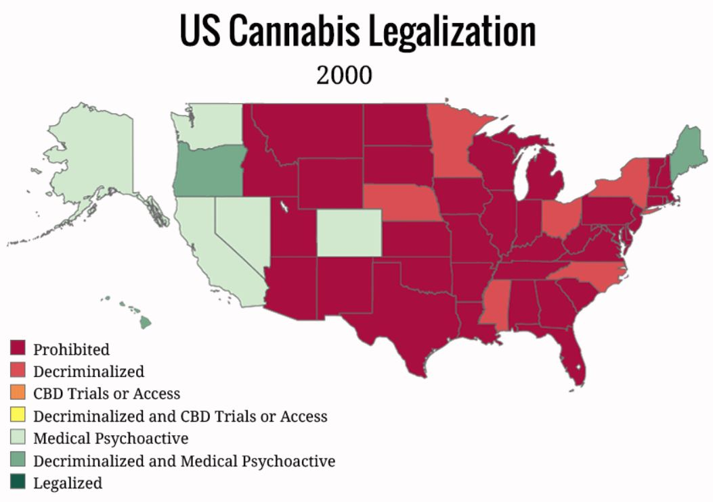
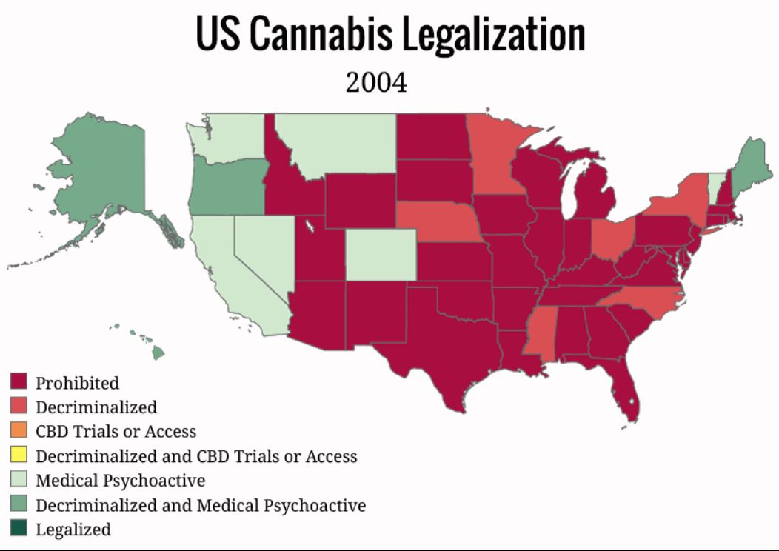
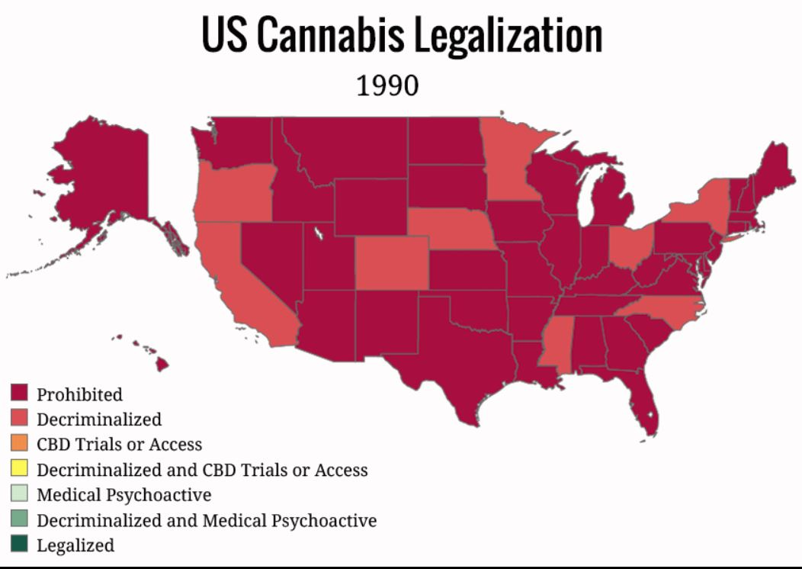
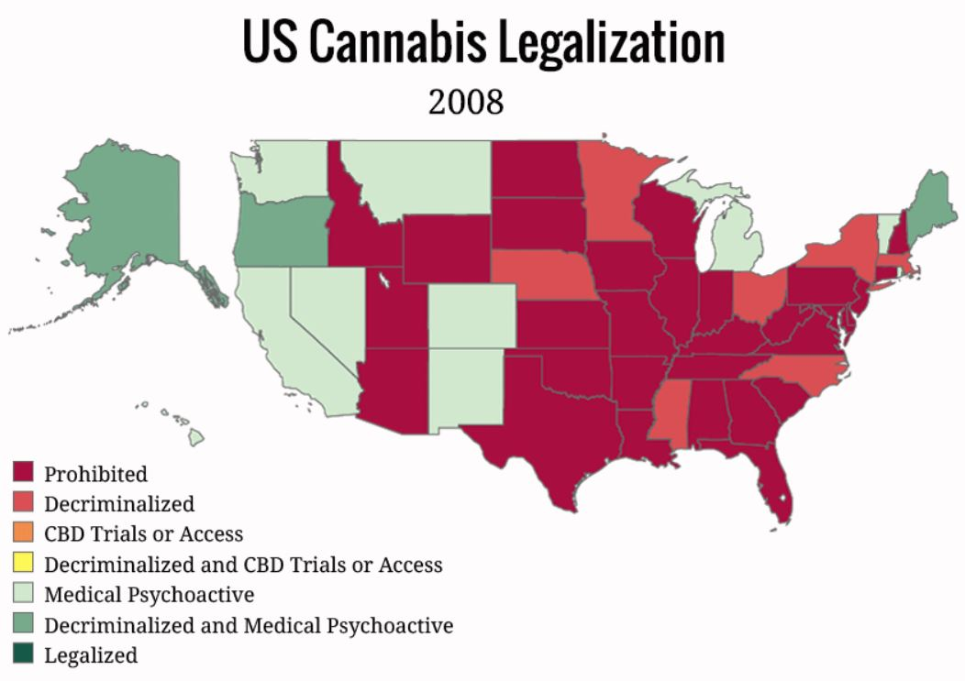

Slide 6
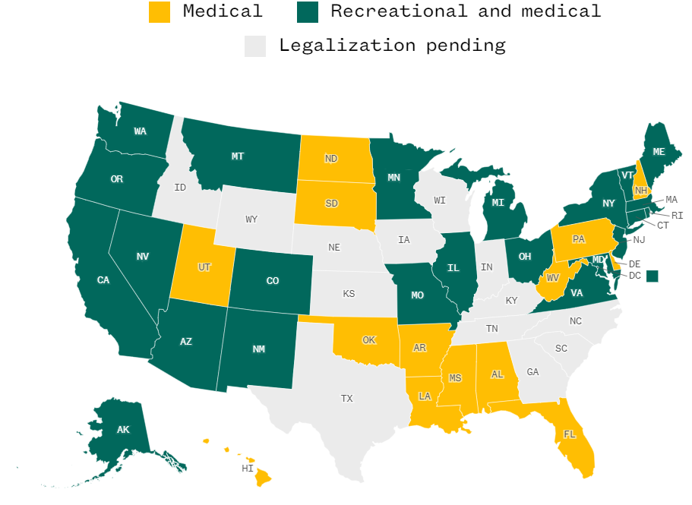
Updated: 4/24
Source: National Conference of State Legislatures / NBC News / MPP.org

Slide 8
-Context -Data -Risky Use -T Breaks

Slide 9
NIDA – News alert (Aug 2022)

Slide 10
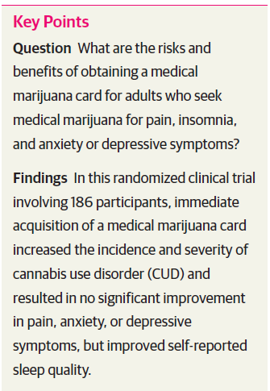
What about Medical Marijuana?

Slide 11
Youth cannabis use
Cannabis Use Among Young Adults in Washington State After Legalization of Nonmedical Cannabis
Kilmer, JR. Am J Public Health. 2022;112(4):638–645. https://doi.org/10.2105/AJPH.2021.306641
Conclusions. Among young adults in Washington, particularly those of legal age, prevalence of cannabis use and cannabis use disorder symptomatology have increased since legalization.

Slide 12
Most commonly used…
ACHA NCHA-III Spring 2021 (Dec 2021) n=70,087
{Lifetime use}
Alcohol = 68.3%
Cannabis = 40.8%
Tobacco or Nicotine = 31.3%
Hallucinogens = 10.5%

Slide 13
Cannabis
Most student have never used
Rates of “lifetime” use…
Of those who have, most use little to none
Rates of “3 month past use”…
While ‘No Use’ is most common among all people
and ‘Infrequent’ use most common of those who have ever used…
…“Daily” use is next most common- and more than 4x higher than daily use of alcohol

Slide 14
“I get high every day
but don’t worry…
it’s after I finish my work”

Slide 17
-Context -Data -Risky Use -T Breaks

Slide 18
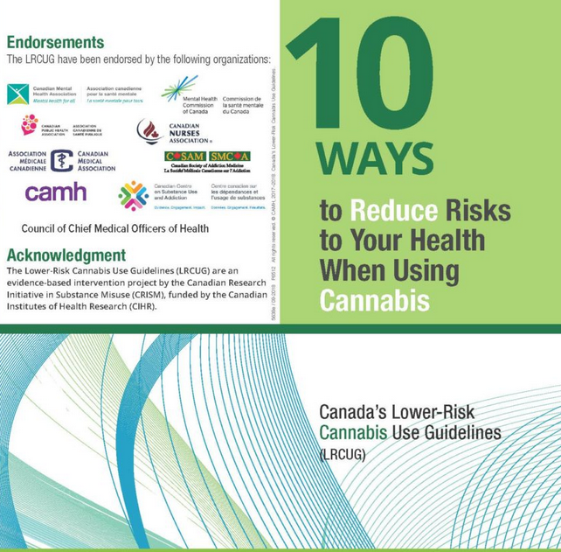
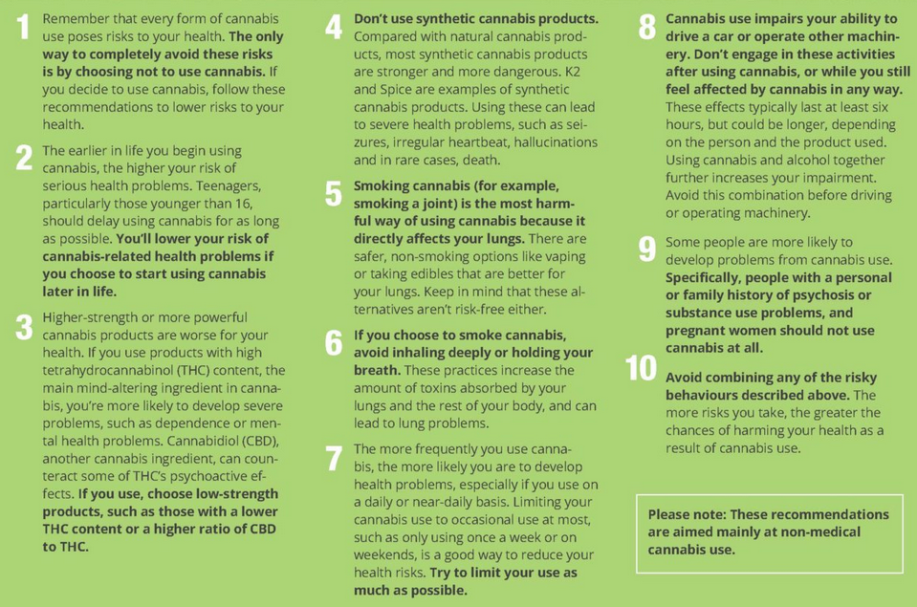
Canada’s Lower-Risk Cannabis Use Guidelines
Fischer, et all 2017: Lower-Risk Cannabis Use Guidelines: A Comprehensive Update of Evidence and Recommendations. American Journal of Public Health 107, e1_e12, https://doi.org/10.2105/AJPH.2017.303818
Website:
https://cml-kml.ca/en/10-ways-to-reduce-risks-to-your-health-while-using-cannabis/

Slide 19
Lower Use Guidelines
1. Abstain
2. Delay Use
3. Lower potency
4. Don’t use synthetics
5. Avoid smoking
6. Don’t breathe deeply
7. Limit frequency
8. Don’t drive
9. Consider family history
10. Avoid combining risks
Trends in Actual Use
1. Use is increasing
2. Age of first use is below 18
3. Potency is soaring
4. Synthetics increasing
5. But flower is still king
6. (that means smoking)
7. Daily use common
8. “I’m a better driver”
9.
10. Teens using high potency, smoked flower regularly

Slide 20
-Context -Data -Risky Use -Tbreaks

Slide 21
The problem of potency and the trouble with tolerance

Slide 22
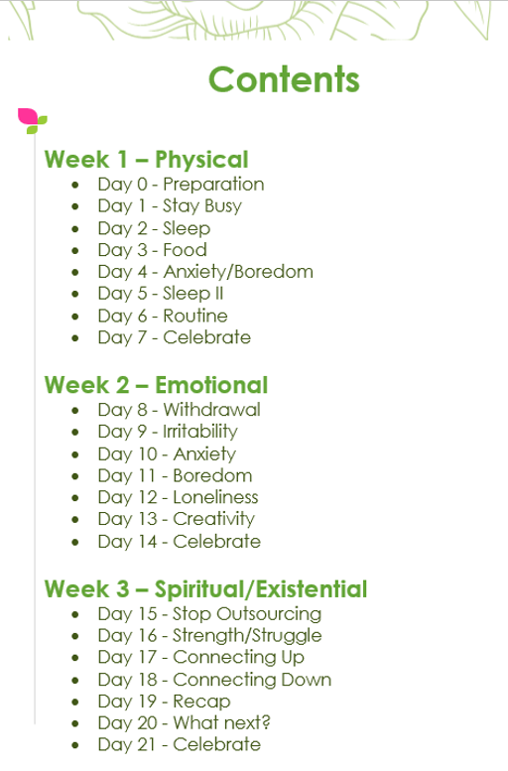
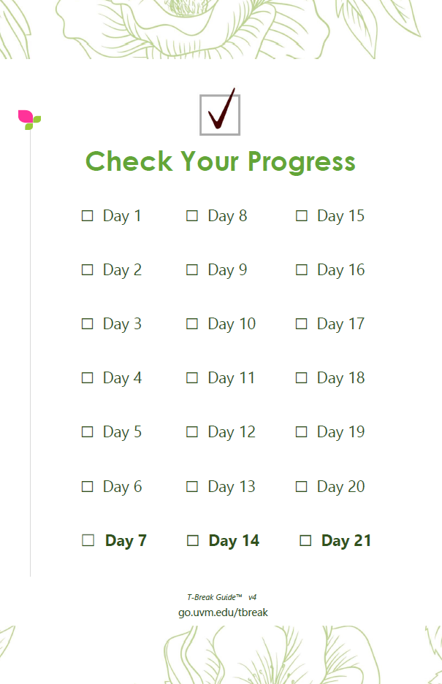
Day 0 - Preparation
Day 1 - Stay Busy
Day 2 - Sleep
Day 3 - Food
Day 4 - Cravings
Day 5 - Sleep II
Day 6 - Routine
Day 7 - Celebrate
Day 8 - Withdrawal
Day 9 - Irritability
Day 10 - Anxiety
Day 11 - Boredom
Day 12 - Loneliness
Day 13 - Creativity
Day 14 - Celebrate
Day 15 - Outsourcing
Day 16 - Connecting In
Day 17 - Escape
Day 18 - Connecting Up
Day 19 - Connecting Down
Day 20 - What Next?
Day 21 – Celebrate
Beyond 21 - Tips & Resources
go.uvm.edu/tbreak

Slide 23
Withdrawal as defined by DSM-5-TR
Three or more of the following…
1. Irritability (anger or aggression)
2. Anxiety (or nervousness)
3. Sleep difficulty (insomnia, etc)
4. Decreased appetite (or weight loss)
5. Restlessness
6. Depressed mood
7. At least one of the following:
abdominal pain, shakiness/tremors, sweating, fever, chills, or headache

Slide 24
Three or more of the following…
1. Irritability (anger or aggression)
2. Anxiety (or nervousness)
3. Sleep difficulty (insomnia, etc)
4. Decreased appetite (or weight loss)
5. Restlessness
6. Depressed mood
7. At least one of the following:
abdominal pain, shakiness/tremors, sweating, fever, chills, or headache

Slide 25
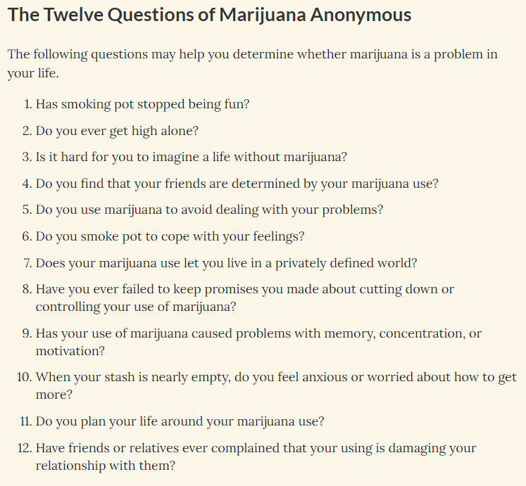

Slide 27
T-Break Guide Study
Thomas JK Fontana, MS – Principal Investigator
Bridget Carsky, BA – Research Assistant & Study Design
Andrea C. Villanti, PhD, MPH – Study Design & Mentor
METHOD:
125 current cannabis users (aged 18-29)
who were willing to take a 21 day break. Participants were offered, but not obligated, to use the T-Break Guide.
They took a baseline survey, and follow-up at 30 days (regardless of completion status)
MEASURES:
Participants were asked about:
If they completed 21 day break
Use since 21 days ended
Confidence in future break
Change in personal definition of “balance”
Other drug use during break
Sorted by frequency of Guide use (none, some, a lot)

Slide 28
T-Break Guide Study
Feasibility and Utility of a Structured Guide for Cannabis Tolerance Breaks in Young Adults
Authors: Thomas JK Fontana, MS, Jonathan A. Schulz, PhD, MPH, Alan J. Budney, PhD, & Andrea C. Villanti, PhD, MPH
RESULTS:
Participants who used the T-Break Guide “a lot” (vs “none”) were more likely to…
complete the 21 days break (84% vs 54%)
plan a future break (32% vs 10%)
report their personal definition of balance has evolved to mean less cannabis (84% vs 55%)
report that they do not see themselves using cannabis in three years (36% vs 4%)
say taking a break was worth it (89% vs 53%)
drink less alcohol- or stop- during break (67% vs 27%)
use less- or stop- other drug use during break (77% vs 36%)

Slide 29
Thank you

Slide 30
Context Data Risky Use T-Breaks Engaging Students

Slide 31
Loyalty Scale
Disloyal
No Loyalty
Low Loyalty
High Loyalty
Xanax
Alcohol
Weed
“Loyalty” = the willingness to attribute negative outcomes to the drug

Slide 33
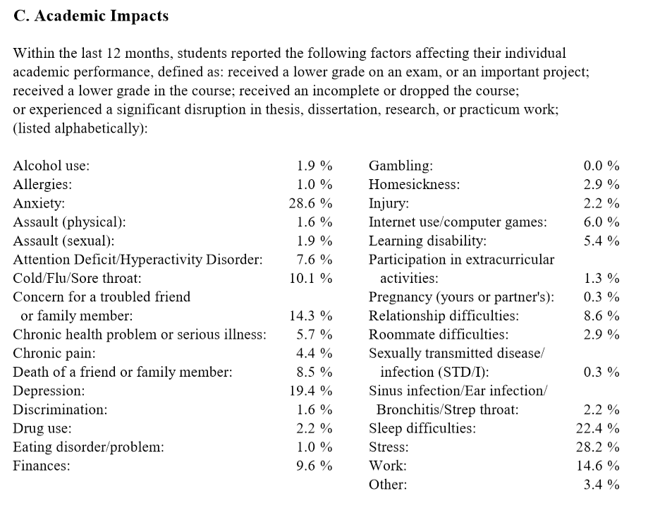

Slide 34
3 effects of
REM deprivation
(1)
(2)
(3)
Cannabis use before
sleep contributes to
REM deprivation
irritability
anxiety
daytime sleepiness
Top 3 barriers to
academic success
(1)
(2)
(3)
stress
anxiety
being tired
Sources:
ACHA NCHA 2017 survey
Colorado Pot Guide, March 2015
Slow dissolving of emotional distress contributes to hyperarousal Rick Wassing PNAS March 1, 2016 113 (9) 2538-2543

Slide 36
Cannabis Edibles
“Start low. Go slow”
Ingestion has a delayed onset of 30 to 90 minutes
Effects reach their maximum effect after 2 to 3 hours
Effects can last 4 to 12 hours (depending on dose and metabolism)
For most…. 5mg to 20mg of THCa brings about psychotropic effects

Slide 37
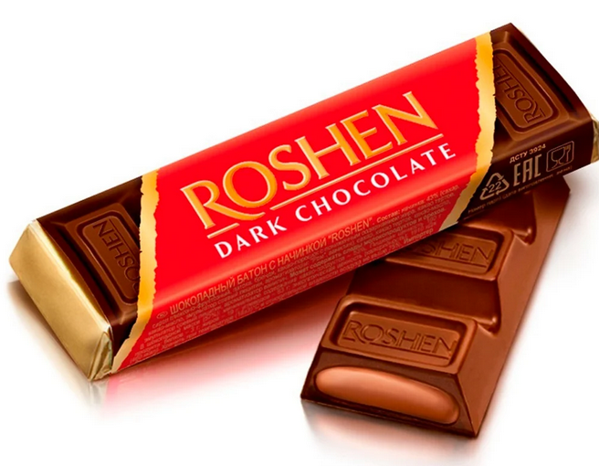
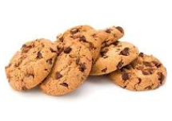
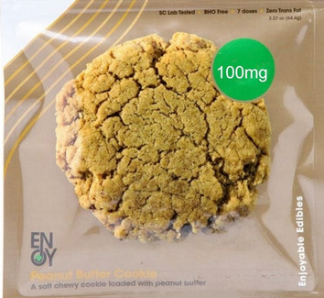
Misleading Serving Sizes
5mg to 20mg is enough for most people, but...
… how many cookies is 1 severing?
… and how much of a chocolate bar?

