Slide 1
Bringing Recovery Allyship to the Classroom
How to Create a Supportive Environment for Students
Zach Runge, M.A.
Notes:
Both

Slide 2
Some Key Facts & Figures at TU
65.5% of TU students drank alcohol in the last 3 months
30.3% of TU students used marijuana/cannabis in the last 3 months
13.5% of TU students used illegal drugs other than marijuana/cannabis in the last year
TU Data based on Randomized Undergraduate Sample, National College Health Assessment Spring 2022: https://www.towson.edu/alcohol-tobacco-drug-prevention-center/documents/ncha-spring-2022.pdf
Notes:
Zack’s slide

Slide 3
Support Services at TU
Tigers in Recovery
Alcohol, Tobacco, and Other Drug (ATOD) Abuse Prevention Center
Counseling Center
Recovery Ally, Adult Mental Health First Aid, Overdose Response Trainings
Accessibility and Disability Services
Notes:
Zack’s slide

Slide 4
Incorporating Allyship: Crafting a Recovery-Friendly Pledge
A pledge is an opportunity for us to express our commitment to supporting students in recovery
According to resources from Recovery Connections (2022), these pledges should aim to be non-discriminatory, open-minded, celebratory, and recovery-specific (emphasizing that it is achievable)
Incorporating a recovery-friendly pledge and information about campus initiatives into our syllabi and discussing them with students during review can go a long way in fostering a supportive environment and raising awareness about resources
Notes:
Zach’s slide

Slide 5
Example Recovery-Friendly Pledge
As a faculty member within the Department of Communication Studies at Towson University, I pledge to foster a recovery-friendly environment for our students, the university, and community at large. I take a supportive approach to recovery, understanding the need for inclusivity and community. I celebrate those in recovery from all forms of addictive behaviors and value their resilience and determination. I understand that recovery does not occur in a straight line and that it must be individualized and inclusive of all experiences. I welcome and celebrate those in all stages of recovery and am committed to advocating for support across the university. I am a trained on-campus recovery ally, meaning members of the university can come to me for a safe and encouraging environment to learn about resources. As work continues to foster this environment, I pledge to research, learn, and promote a recovery-friendly approach in all aspects of my work.
Notes:
Zach’s slide

Slide 6
Example Substance Use Resources Language
Students impacted by substance use or who are actively in recovery have a variety of support services available on TU’s campus. Supportive communities are a key resource needed for successful drug prevention and harm reduction efforts. For more information, including our collegiate recovery program, please visit the Alcohol, Tobacco, & Other Drug Abuse (ATOD) Prevention Center’s website at https://www.towson.edu/alcohol-tobacco-drug-prevention-center/ or email atod@towson.edu.
Notes:
Zach’s slide

Slide 7
Incorporating Allyship: Promoting Campus and Community Resources
Design and implement a resource module in your course’s learning management system (Blackboard, Canvas, etc.)
The module can include information about campus resources and trainings as well as local community resources to connect with
Look for easily accessible and understandable resources that can also help to explain what to say, what not to say, and why
Example: Recovery Research Institute’s Addictionary can help faculty and students make a conscience effort to use empathetic, person-first language
Providing access to campus and community resources within their courses may help students impacted by substance use know the supports available to them
Notes:
Zach’s slide

Slide 8
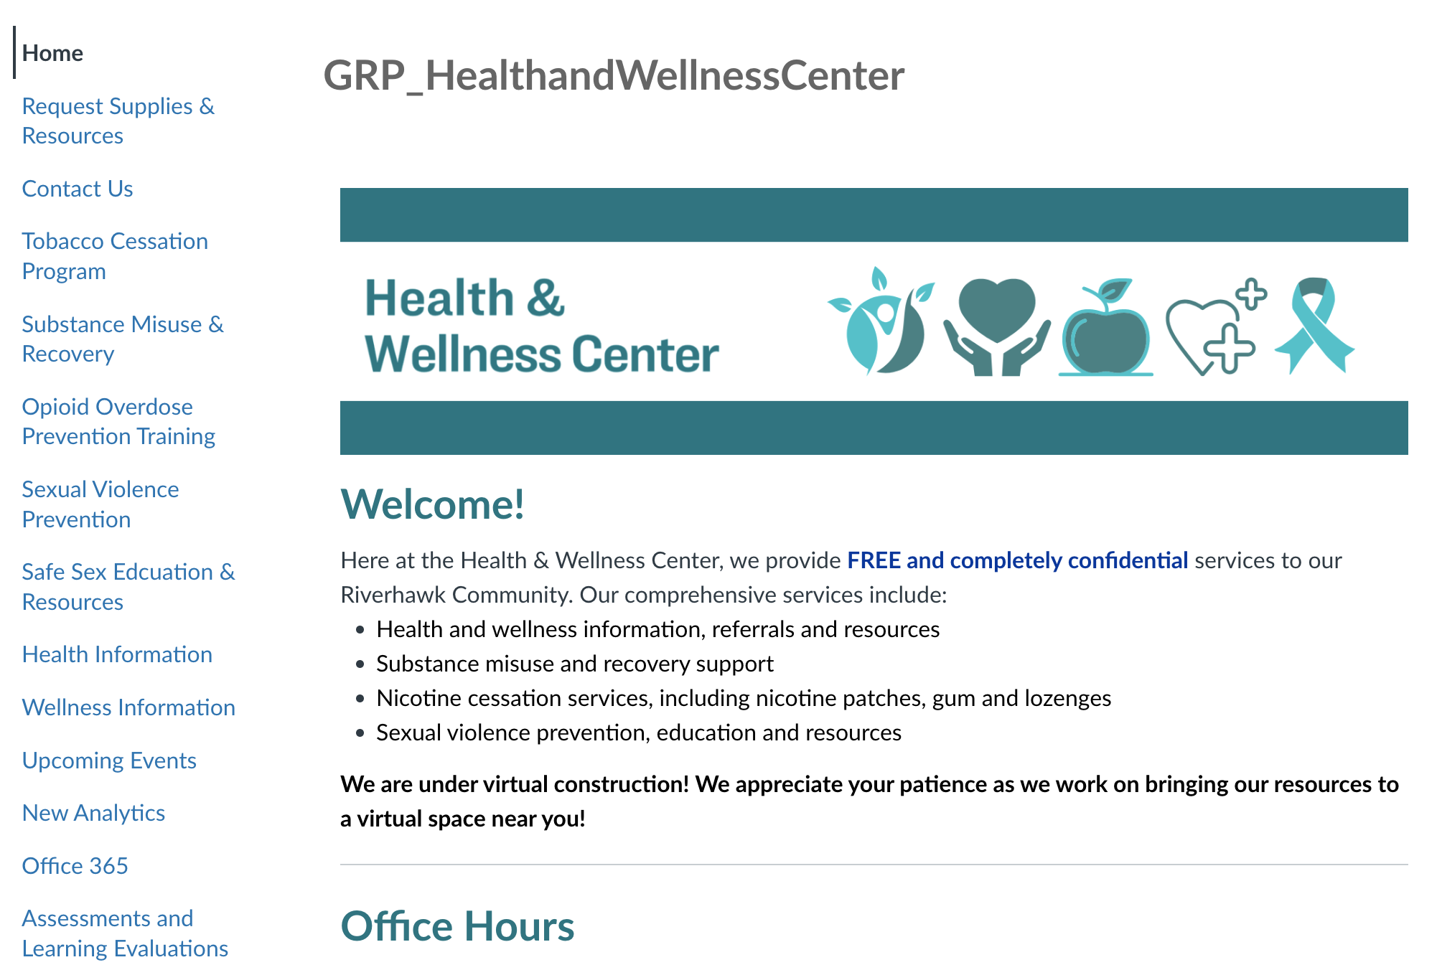
Example LMS Resource Hub from Anne Arundel Community College

Slide 9
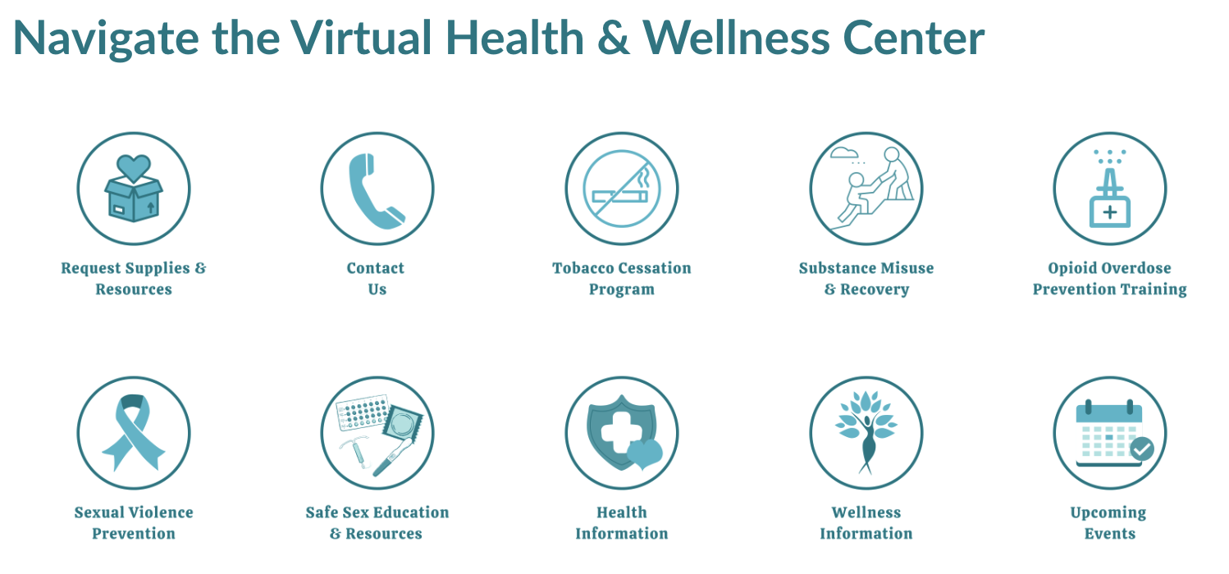
Example LMS Resource Hub Cont.

Slide 10
Tips for Implementing a LMS Resource Hub
Partner with your university’s ATOD Prevention and/or Counseling Centers to include all relevant information and policies
Keep it as up-to-date as possible with campus and community trainings, events, etc. as well as current research and discussions from the field
Periodically remind students about the hub in a low-stakes way – it is a resource, not a requirement
Notes:
Zach’s slide

Slide 11
Incorporating Allyship: Raising Awareness through Assignments
Consider adding assignments or segments that discuss substance use and recovery in meaningful ways
Example: In my Rhetorical Theory & Criticism course, we have a module focused on the messages in popular culture texts surrounding substance use and the impact on audiences’ understanding of it
Example: In my Public Speaking course, I use the topics of substance use/recovery when providing example informative or persuasive speeches
Some courses/subject areas may be easier to incorporate assignments related to substance use and recovery than others
Whether or not you can integrate these types of assignments/discussions, continue to promote training and resources to students. Be open to discussing their experiences without judgement or stigma
Notes:
Zach’s slide

Slide 12
Common Complaints from Students
Being asked to present or talk about substance use or recovery
Comments that normalize substance use
Food with alcohol
Having it assumed they want to work in substance use or treatment fields
Notes:
Zack’s slide

Slide 13
Putting Allyship into Practice
Let’s collaborate! Share your own ideas for ways to incorporate recovery allyship in our classrooms/curriculum
What are some initiatives you may already be implementing or plan to implement?
Notes:
Zach’s slide

Slide 14
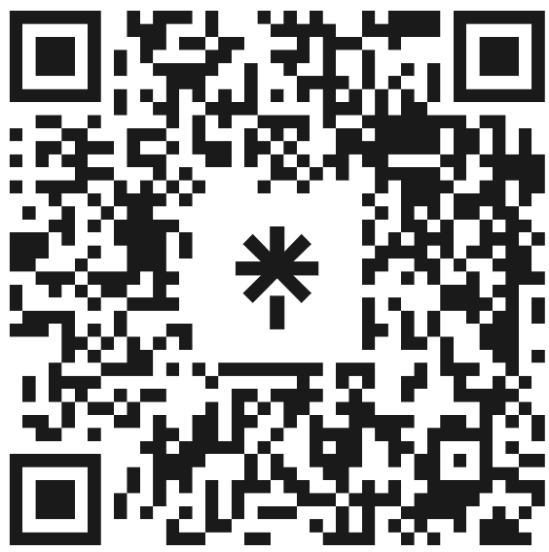
Additional Allyship Resources
If you want to learn more about how to support students in recovery, scan the QR code or visit linktr.ee/recovery_resources
Notes:
Zach’s slide

Slide 15
References
American Academy of Pediatrics. (2022, May 23). Recommended terminology for substance use disorders in the care of children, adolescents, young adults, and families. https://publications.aap.org/pediatrics/article/149/6/e2022057529/188090/
Johns Hopkins Medicine. (2022, July 6). Words matter: Reducing the stigma of addiction through language [Video]. YouTube. https://www.youtube.com/watch?v=2xdQELDZ73g
Opioid Operational Command Center. (2023). Maryland’s overdose data dashboard. State of Maryland. https://beforeitstoolate.maryland.gov/dashboard
Perron, B. E., Grahovac, I. D., Uppal, J. S., Granillo, M. T., Shutter, J., & Porter, C. A. (2011). Supporting students in recovery on college campuses: Opportunities for student affairs professionals. Journal of student affairs research and practice, 48(1), 47–64. https://doi.org/10.2202/1949-6605.622
Recovery Connections (2022, July). Developing a Recovery Friendly University Pledge. https://www.recoveryconnections.org.uk/recovery-friendly-pledge/
Research Recovery Institute (n.d.). Addictionary. https://www.recoveryanswers.org/addictionary/
Notes:
Both

Slide 16
Thank You!
Zach Runge: zrunge@towson.edu
Notes:
Both

