Slide 1
Implementing the Social Model of Disability to Support Students in Recovery
Joanna Timmerman, MA (she/her)
Dee Singley, PhD (she/they)

Slide 2
Recovery in Higher Education
Recovery defined:
Students who are actively working to manage substance use disorders to maintain sobriety
Process of change where students have expectations to improve health and wellness
Developing a new lifestyle and set of coping mechanisms to manage stress, emotions, and triggers
Live self-directed lives
What recovery looks like for a college student:
Balancing academic, social pressures and personal wellness.
Managing triggers (social, academic, and environmental)
Pressure, campus culture, access to substances
Navigating barriers:
Stigma
Lack of inclusive policies
Rigid academic schedules
Inflexible systems
Inadequate support systems

Slide 3
The Americans with Disabilities Act
A person has a disability under the ADA if the person:
Has a physical or mental impairment that substantially limits one or more major life activities
Has a history of an impairment that substantially limited one or more major life activities
Is regarded as having such an impairment
Major life activities include, but are not limited to: walking, seeing, caring for oneself, learning, working, thinking, communicating and also the operation of bodily functions, such as neurological and brain functions
Addiction [substance use disorder] is generally considered a disability because it is an impairment that affects brain and neurological functions
ADA National Network

Slide 4
Challenges to supporting recovery under ADAAA:
Often based on medical models focused on diagnosis and treatment
Limited flexibility in meeting students’ recovery needs
ADAAA is minimum requirements
Burdensome processes for students to obtain necessary supports
Intersectionality

Slide 5
What are the different models of disability?
Charitable (indiv. needs special segregated services)
Medical (indiv. needs to be “fixed”)
Biopsychosocial (indiv. has negative attitudes)
Primarily developed and promoted by American private health care sector
Social (society needs to be fixed)
Inclusion London

Slide 6
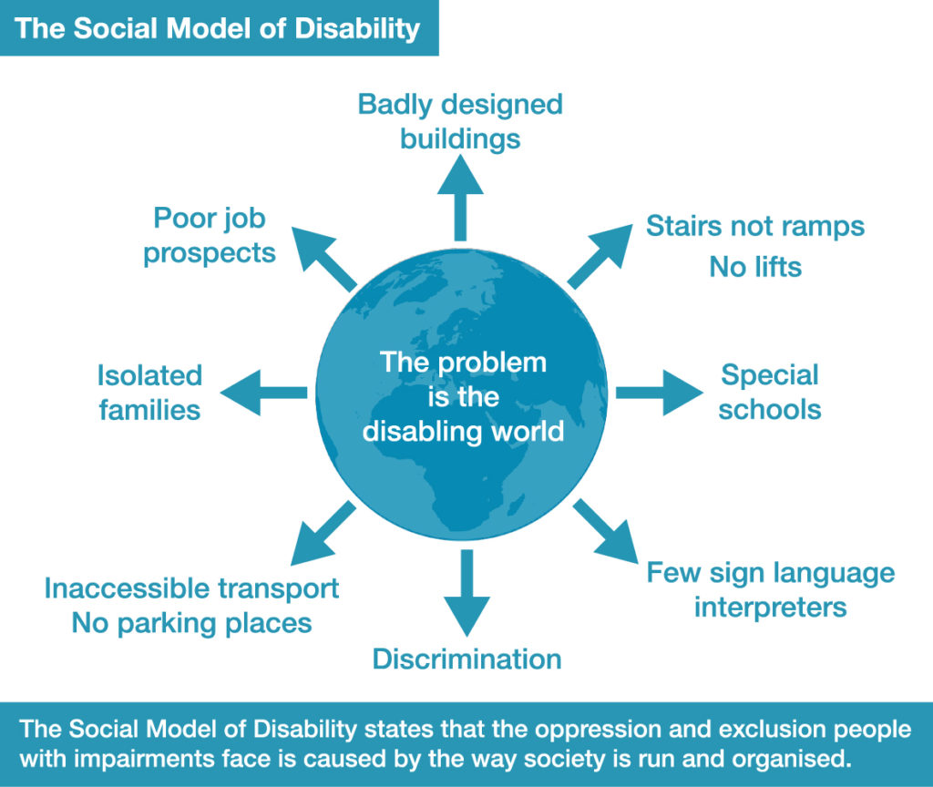
The Social Model of Disability
Holds that people with impairments are ‘disabled’ by the barriers operating in society that exclude and discriminate against them
Sometimes referred to as a “barriers approach”
Inclusion London

Slide 7
Types of barriers identified by the Social Model
Attitudinal Barriers (e.g., can’t be independent, can’t have sex, shouldn’t have children, need protecting, are “dangerous,” etc.)
Physical Barriers (e.g., stairs/ steps, narrow corridors, inaccessible housing, poor lighting, poorly managed street and public spaces, etc.)
Information/Communication Barriers (e.g., lack of provision of interpreters, lack of information in different accessible formats, etc.)
Inclusion London

Slide 8
Quick detour: A note on language
Impairment is an individual’s physical, sensory or cognitive difference.
Disability is the name for the social consequences of having an impairment. People with impairments are disabled by society, so disability is therefore a social construct that can be changed and removed.
Avoid language that implies deficits (e.g., “confined to a wheelchair,” or “suffering from anxiety”)
Inclusion London

Slide 9
What about person-first language?
Using the word ‘Disabled’ before ‘people’ signifies identification with a collective cultural identity and capitalising the ‘D’ emphasises the term’s political significance. Using the term ‘Disabled people’ or ’Disabled person’ is therefore a political description of the shared, disabling experience that people with impairments face in society.
However, you should always defer to the Disabled person for their preference!
Disability Rights UK

Slide 10
Removing or reducing barriers
Often, the solutions to barriers benefit everyone, not just Disabled people
Barrier: steps to an entrance make the space inaccessible to wheelchair users
Solution: installation of a ramp and actuator on the door
Additional benefits: people pushing strollers or carrying multiple items can use this entrance with ease
Barrier: apartment intercom system does not have video, making it inaccessible to Deaf and HoH users
Solution: installation of a video intercom system
Additional benefits: people who feel vulnerable may feel more secure
Inclusion London

Slide 11
Universal Design
Equitable Use - Provide the same means of use for all users: identical whenever possible; equivalent when not
Flexibility in Use - Provide adaptability to the user's pace
Simple and Intuitive Use - Arrange information consistent with its importance
Perceptible Information - Use different modes (pictorial, verbal, tactile) for redundant presentation of essential information
Tolerance for Error - Arrange elements to minimize hazards and errors
Low Physical Effort - Allow user to maintain a neutral body position
Size and Space for Approach and Use - Provide adequate space for the use of assistive devices or personal assistance
Center for Excellence in Universal Design

Slide 12
Using the Social Model on college campuses
Dismantling attitudinal barriers:
Campus-wide conversations about ableism
Viewing disability as diversity and culture
Promoting universal design with faculty and campus partners
Dismantling institutional barriers:
Reconsidering documentation guidelines or requirements
Designating accessible spaces
Ensuring clear and digestible communication

Slide 13
Brainstorming solutions (pt. 1)
Barrier: pressure or expectations to participate in drug use
Solution: recovery-supportive social programming
Additional benefits: more opportunities for social connection and belonging with diverse interests
Barrier: negative attitudes around people with SUD or in recovery
Solution: bias and ally training for faculty and staff
Additional benefits: addresses biases across a variety of identities
ARHE

Slide 14
Brainstorming solutions (pt. 2)
Barrier: isolation from support systems or mutual aid meetings
Solution: college-provided or sponsored transportation in the community (e.g., BMC Septa Pass)
Additional benefits: supports students who need to work or are caretakers
Barrier: proximity to drugs and use
Solution: recovery housing or other housing accommodations
Additional benefits: supports students with PTSD or anxiety, etc.
ARHE

Slide 15
Benefits of employing a Social Model
Environmental First Approach
Places responsibility on institutions to address discrimination and systemic barriers
Easier, faster support for students in recovery
Inclusive, less bureaucratic process
Focus on proactive change (not reactive)
Reduces culture of shame or stigma surrounding SUD and recovery
Holistic and responsive to student needs

Slide 16
Thank you! Questions?
joannatimmerman@gmail.com
dee.m.singley@gmail.com

