Slide 1
Opioid Response Network
The Horse is Barking: Understanding Trauma and Substance Use Disorders
Stina Jacobs, LMSW, CCTS-I
April 9, 2026

Slide 2
Working with communities.
The SAMHSA-funded Opioid Response Network (ORN) assists states, tribes, organizations and individuals by providing the resources and technical assistance they need locally to address the opioid crisis and stimulant use.
Technical assistance is available to support the evidence-based prevention, treatment, recovery and harm reduction of opioid use disorders and stimulant use disorders.

Slide 3
Working with communities.
The Opioid Response Network (ORN) provides local, experienced consultants in prevention, treatment, recovery and harm reduction to communities and organizations to help address this opioid crisis and stimulant use.
ORN accepts requests for education and training.
Each state/territory has a designated team, led by a regional Technology Transfer Specialist (TTS), who is an expert in implementing evidence-based practices.

Slide 4
Contact the
Opioid Response Network
To ask questions or submit a technical assistance request:
    Visit www.OpioidResponseNetwork.org
    Email orn@aaap.org

Slide 5

Substance Abuse and Mental Health
Services Administration (SAMHSA)
Funding for this initiative was made possible (in part) by grant no. 1H79TI088037 from SAMHSA. The views expressed in written conference materials or publications and by speakers and moderators do not necessarily reflect the official policies of the Department of Health and Human Services; nor does mention of trade names, commercial practices, or organizations imply endorsement by the U.S. Government.

Slide 6
Approach: To build on existing efforts, enhance, refine and fill in gaps when needed while avoiding duplication and not
“recreating the wheel.”

Slide 7
Overall Mission
To provide training and technical assistance via local experts to enhance prevention, harm reduction, treatment (especially medications like buprenorphine, naltrexone and methadone) and recovery efforts across the country addressing state and local - specific needs.

Slide 8
Disclosures
AAAP is committed to presenting learners with unbiased, independent, objective, and evidence-based education in accordance with accreditation requirements and AAAP policies.
Presenter(s), planner(s), reviewer(s), and all others involved in the planning or content development of this activity were required to disclose all financial relationships within the past 24 months.
All disclosures have been reviewed and there are no relevant financial relationships with ineligible companies to disclose

Slide 9

ORN Evaluation Survey Link
The grant that provided funding for this training requires that we request you to complete the brief survey linked below. Your feedback is important and provides support for this type of work to continue. Scan the QR Code to access the SAMHSA feedback survey.
Post-Event Survey URL: https://lanitek.com/P?s=618630
The survey will ask about your satisfaction with the training program you just completed as well as some basic demographic information. Your responses will help the Opioid Response Network improve the services they provide.
Thank you in advance for completing this survey!

Slide 10
OBJECTIVES
Define the connection between trauma and substance use disorders.
Recognize and explore “The Barking Horse” as a clinical metaphor for symptom behavior.
Examine the role of the nervous system and survival responses.
Promote a shift from pathology to compassion.

Slide 11
The Connection Between Trauma and SUDs
Trauma (acute, chronic, or complex) creates emotional, physiological, and cognitive distress. Many individuals use substances as a way to cope with or escape this distress. This sets the stage for a powerful cycle in which trauma contributes to the development of SUDs and is worsened by the consequences of substance use.
Trauma increases vulnerability to SUDs
SUDs can become a maladaptive coping strategy
Substance use increases risk for further trauma
Trauma and SUD share neurobiological pathways
References provided at the end of the power point.

Slide 12
Introduction: When the Horse Barks
The phrase “the horse is barking” symbolizes behaviors that are out of the ordinary.
In the same way, substance use, relapse, or other maladaptive behaviors are signals that something is wrong.
GOAL: Shift perspective from judgement to curiosity

Slide 13
Trauma and Addiction: The Hidden Link
Over 70% of individuals with SUDs report a history of trauma
Substance use often emerges as a survival strategy- a way to numb, escape, or regulate overwhelming emotions
Headaches,
Chest pain, increased heart rate, or high blood pressure,
Fear,
Anger
Exhaustion,
Anxiety,
Numbness,
Disorganized thinking - e.g., not being able to remember the event accurately,
Sleep disturbances,
Grief, or sadness.

Slide 14
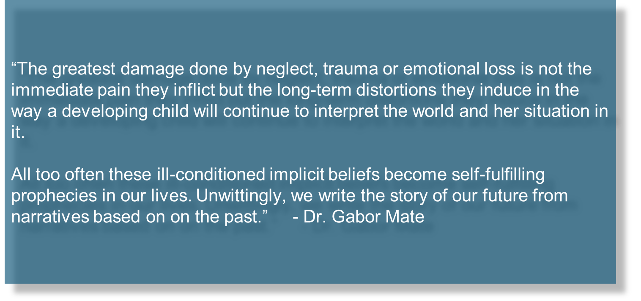
Trauma and Addiction: The Hidden Link
Trauma impacts brain development, attachment, and the stress response.

Slide 15
The Barking Horse Metaphor
A horse barking = unnatural; it means the system is in distress.
Behaviors like resistance, manipulation, or self-sabotage are not “the problem” – they are “the signals.”
Our task: Listen for the bark and ask, “What happened to you?”

Slide 16
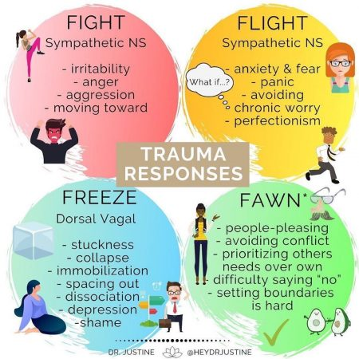
The Impact of Trauma
The stress response.
The body remembers even when the mind forgets.
Substances can mimic regulation, providing temporarily relief.

Slide 17
Trauma Informed Care Principles
Safety: Physical and emotional security.
Trustworthiness: Clear, consistent, predictable, boundaries
Empowerment: Strengths-based approaches
Collaboration: Shared-decision making
Cultural Humility: Respect for diverse experiences of trauma

Slide 18
Reframing and Clinical Responses
Old Question: “What’s wrong with you?”
New Question: “What happened to you?”
Practice compassion over control; curiosity over compliance.
Every maladaptive behavior once served a purpose.
“To understand your addiction, you have to understand what the drugs did for you in the first place.” – Dr. Gabor Mate

Slide 19
Practical Strategies for Providers
Integrate trauma screening in assessment.
Use grounding and body-based techniques.
Employ MI and IFS to enhance self-compassion and insight.
Reflect on countertransference and staff stress responses.

Slide 20
Listening for the Bark in Treatment
Notice behavioral patterns that may indicate trauma: withdrawal, hypervigilance, avoidance, anger.
Respond with empathy and validation.
Create moments of safety that restore regulation and trust.

Slide 21
Closing Reflection – When the Horse Barks
Shift in perspective:
  Substance use behaviors are messages, not moral failures.
  Our role: to listen, interpret, and respond with care.
  “When the horse barks, don’t punish it — listen.”
Takeaway: Healing begins when we recognize that behavior is communication.

Slide 22
References
National Institute on Drug Abuse. (2023). Comorbidity: Substance use disorders and other mental illnesses. National Institutes of Health. https://nida.nih.gov/publications/drugfacts/comorbidity-substanceuse-disorders-other-mental-illnesses
Substance Abuse and Mental Health Services Administration. (2020).
Trauma-informed care in behavioral health services (Treatment Improvement Protocol Series, No. 57). U.S. Department of Health and Human Services. https://store.samhsa.gov/product/tip-57- trauma-informed-care-behavioral-health-services/pep20-02-01-003
Substance Abuse and Mental Health Services Administration. (2014).
SAMHSA’s concept of trauma and guidance for a trauma-informed approach (HHS Publication No. SMA 14-4884). U.S. Department of Health and Human Services. https://library.samhsa.gov/sites/default/files/sma15-4420.pdf
van der Kolk, B. A. (2014). The body keeps the score: Brain, mind, and body in the healing of trauma. Viking Press.

Slide 23
ORN Evaluation Survey Link
The grant that provided funding for this training requires that we request you to complete the brief survey linked below. Your feedback is important and provides support for this type of work to continue. Scan the QR Code to access the SAMHSA feedback survey.
Post-Event Survey URL: https://lanitek.com/P?s=618630
The survey will ask about your satisfaction with the training program you just completed as well as some basic demographic information. Your responses will help the Opioid Response Network improve the services they provide.
Thank you in advance for completing this survey!

